Slide 2
Inheritance

Slide 3
Inheritance is most powerful feature of OOPS . In C++ ,it is implemented by creating the new classes from the existing class.
The main idea behind inheritance is to reused, enhance and increase the reliability of already ,existing code. Because of this the inheritance saves not only the precious time and money but also lessens the burden and frustration of the programmer.

Slide 4
BASED ON THE DESIGNMANY CARS ARE MANUFACTURED.
IF WE WANT A NEW DESIGN WE ARE NOT DESIGNING FROM SCARTCH
NEW FEATURES ARE ADDED TO THE OLD DESIGN CAR
CAR

Slide 5
SIMILARILY TV VERSIONS
SAME CONCEPTS WE R USING IN PROGRAMMING.
FOR EX:
CLASS RECTANGLE LENGTH,BREADTH
CUBOID ---LENGTH,BREADTH AND HEIGHT.
SO WE CAN REUSE THE LENGTH AND BREADTH FROM BASE CLASS RECTANGLE

Slide 6
Inheritance
BASE CLASS
DERIVED CLASS

Slide 7
#INCLUDE<IOSTREAM>
USING NAMESPACE STD;
CLASS BASE
{
PUBLIC:
INT X;
VOID SHOW()
{
COUT<<”X=”<<X;
}
};
CLASS DERIVED: PUBLIC BASE
{
PUBLIC:
INT Y;
VOID DISPLAY()
{
COUT<<X<<” “ <<Y;
}
};
INT MAIN()
{
BASE B;
B.X=25;
B.SHOW();-------→DISPLAYS X VALUE
DERIVED D;
D.X=20;
D.Y=30;
D.DISPLAY();----→ DISPLAYS BOTH X AND Y VALUE
}

Slide 8
Base class:
Derived class:
X-variable
Show() function
Y variable
Display() function
X-variable
Show() function

Slide 9
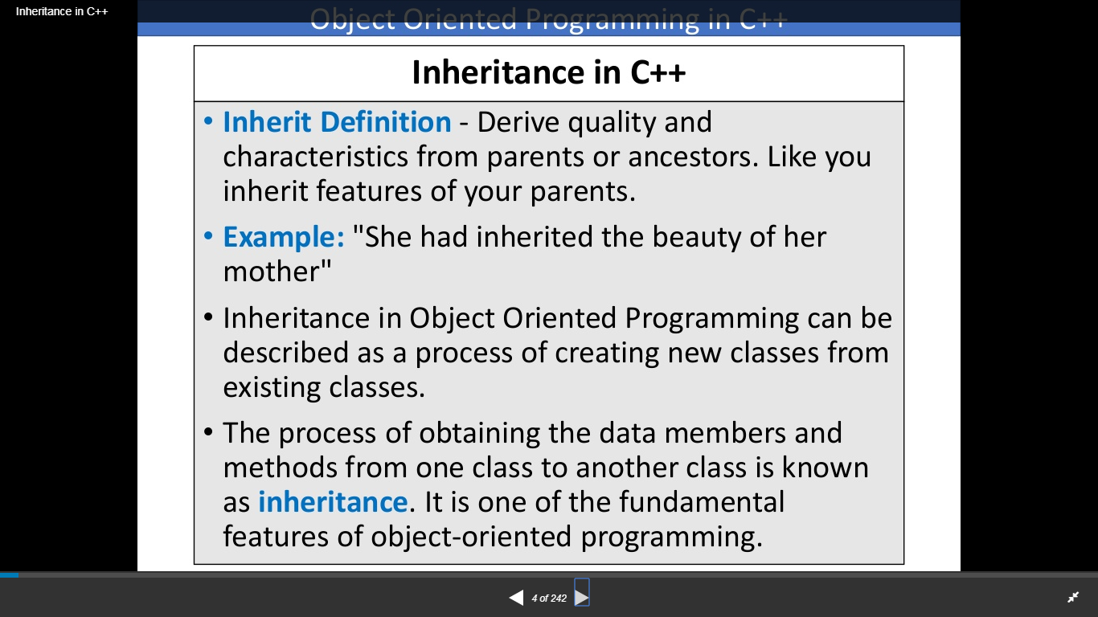

Slide 10
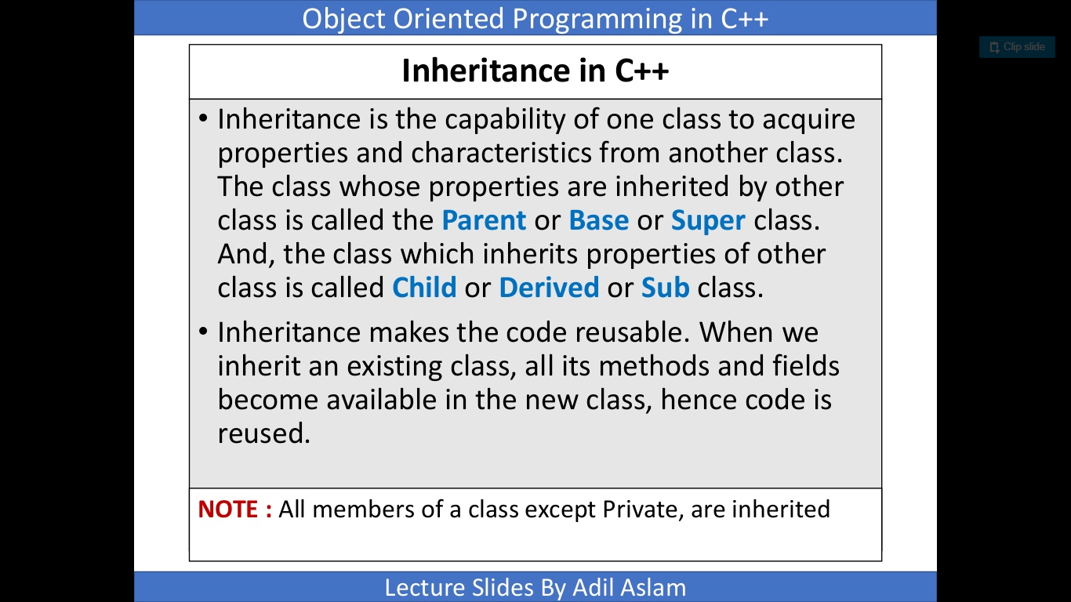

Slide 11
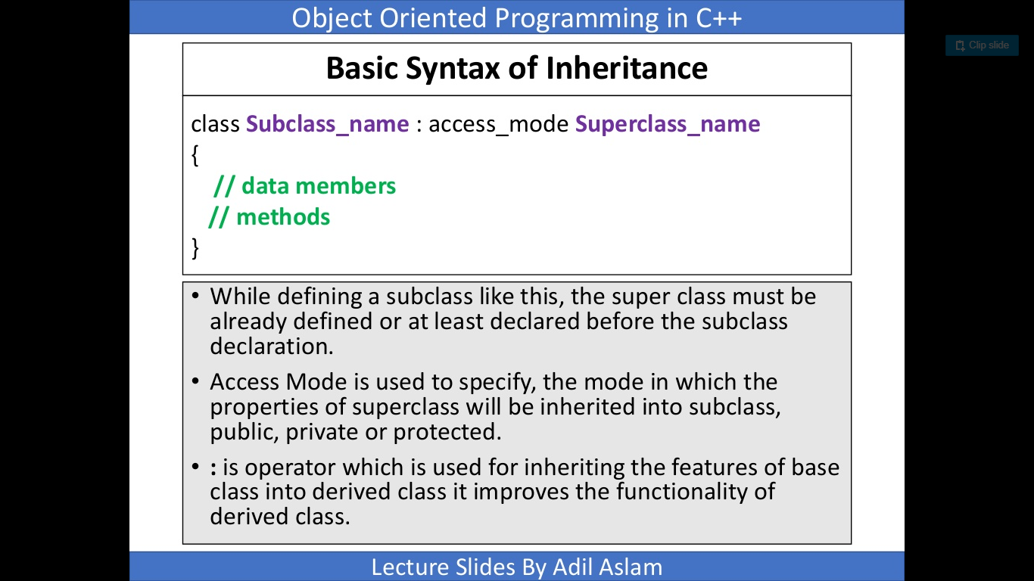

Slide 12
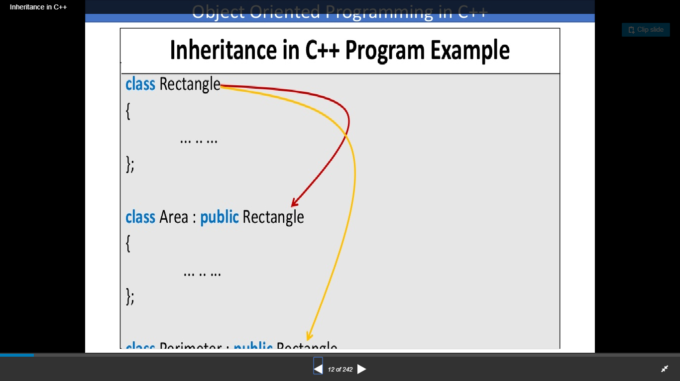

Slide 13
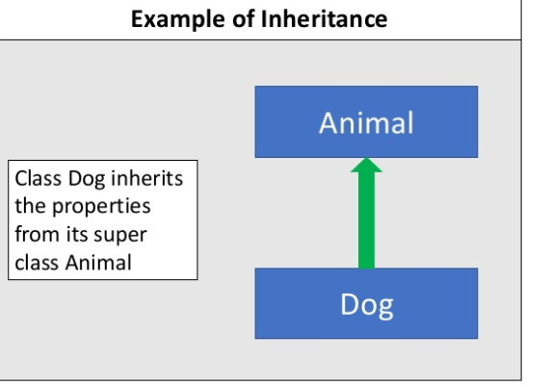

Slide 14
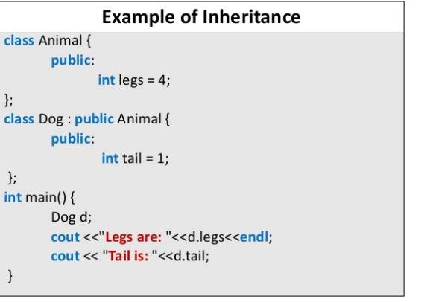

Slide 15
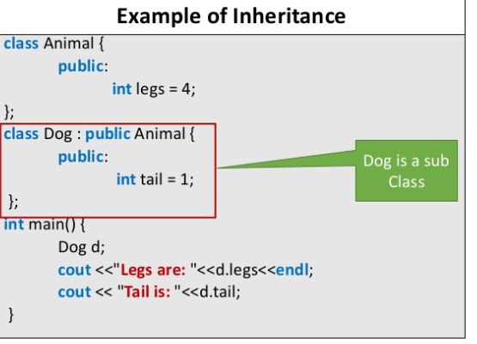
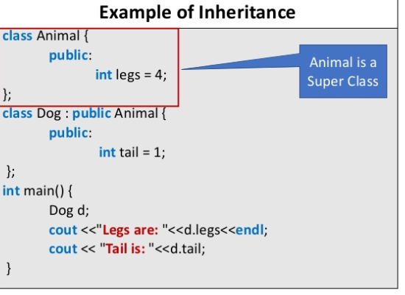

Slide 16
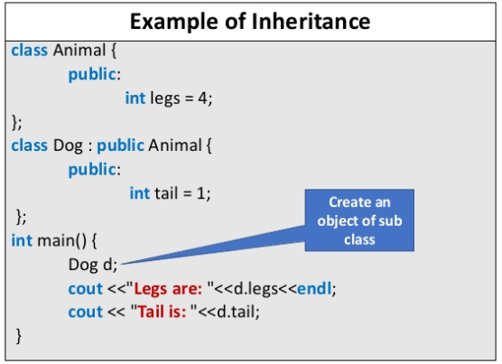

Slide 17
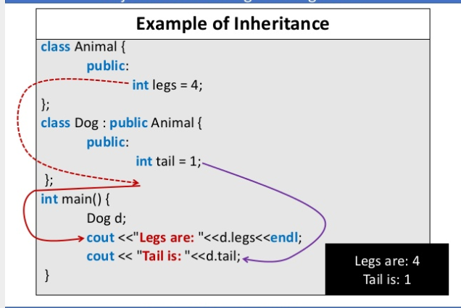

Slide 18
INHERITANCE PRGM-1
INHERITANCE PRGM-2

